Slide 1

Secure Cloud Storage with Hybrid Encryption Using AES and RSA
COURSE NAME: CRYPTOGRAPH AND NETWORK SECURITY
COURSE CODE: CSA1221
PRESENTED BY:
NAME: VIMAL R
REG NO: 192421350
GUIDED BY:
DR.T. SANGEETHA

Slide 2
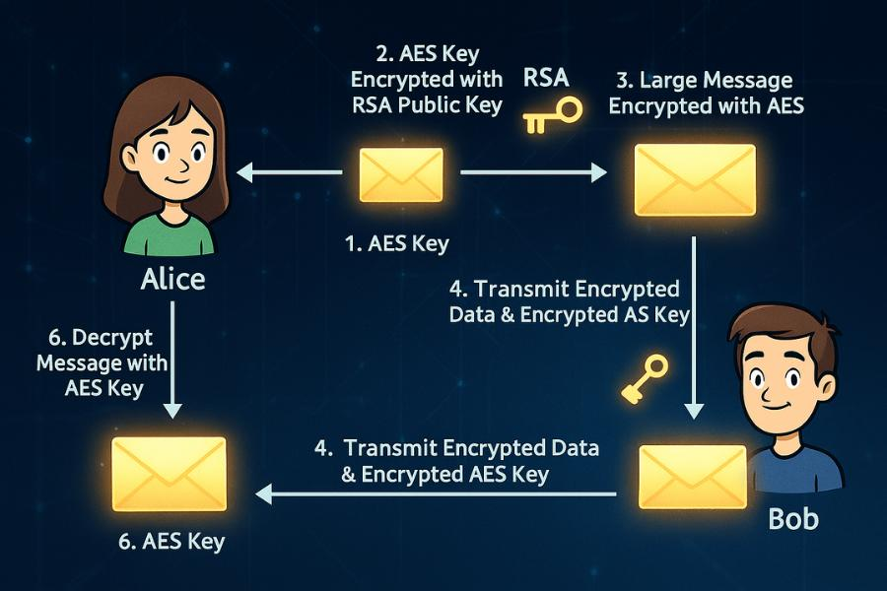
INTRODUCTION
Secure Cloud Storage
Cloud storage enables users to store and access data through remote servers.
Organizations use cloud platforms to store documents, images, databases, and confidential information.
Data stored in the cloud may be exposed through unauthorized access or compromised accounts.
Encryption converts readable plaintext into unreadable ciphertext.
The proposed system encrypts files before they are stored in the cloud.
AES is used for fast file encryption.
RSA is used to securely protect the AES encryption key.
This combination is called Hybrid Encryption.
Key Idea
File → AES Encryption → Ciphertext
AES Key → RSA Encryption → Protected Key

Slide 3
PROBLEM STATEMENT
Existing Security Challenges
Cloud storage may contain highly sensitive user information.
Storing plaintext files increases the impact of a storage breach.
Password authentication alone cannot protect files after unauthorized storage access.
RSA provides secure public/private key mechanisms but is inefficient for large files.
Managing and storing encryption keys securely is a major challenge.
A single cryptographic technique cannot efficiently solve both problems.
Problem
How can we provide strong file confidentiality while maintaining efficient encryption and secure key management?

Slide 4
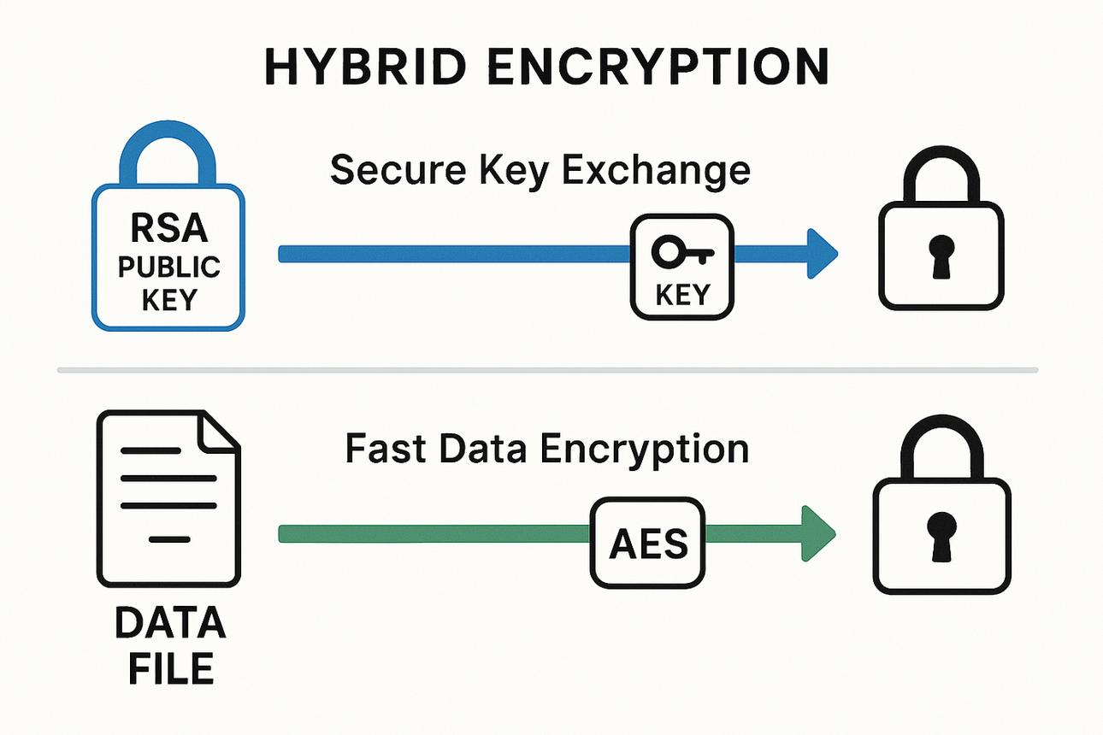
PROPOSED SYSTEM
Proposed System
The proposed system is a secure cloud storage application that combines AES (Advanced Encryption Standard) and RSA (Rivest–Shamir–Adleman) to provide hybrid encryption.
The system will:
Authenticate users before allowing access.
Encrypt files using the AES algorithm before upload.
Encrypt the AES key using RSA for secure key distribution.
Allow only authorized users to download and decrypt files securely.

Slide 5
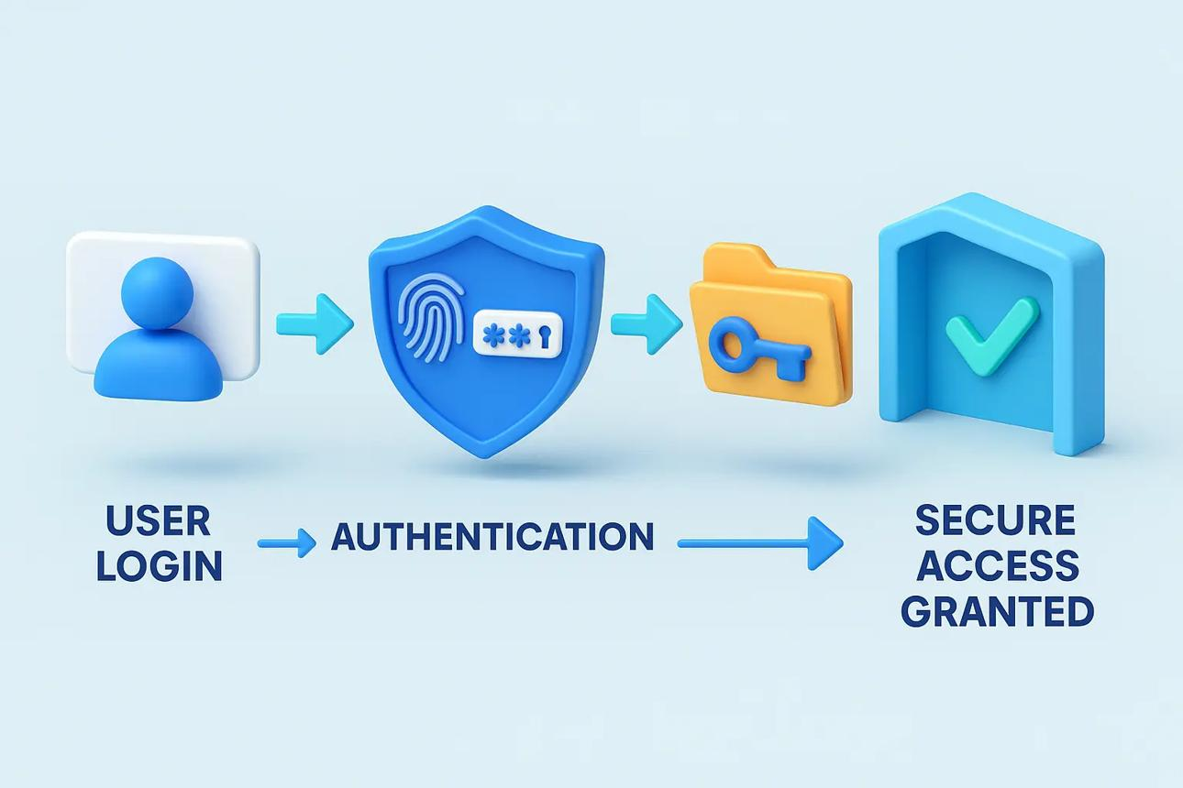
MODULE 1: USER AUTHENTICATION
User Authentication
Functions
User Registration
User Login
Password Verification
Session Management
Access Control
Working
User → Login → Credential Verification → Authentication → Dashboard
Purpose
Prevent unauthorized access.
Restrict file operations to authenticated users.
Provide the first security layer.

Slide 6
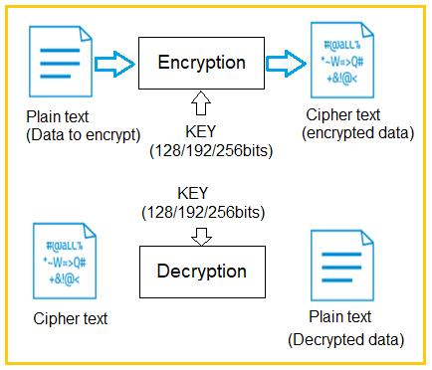
MODULE 2: AES FILE ENCRYPTION
Purpose
This module protects the actual contents of files using the AES-256 symmetric encryption algorithm.
Main Functions
File Selection
AES Key Generation
Plaintext File Processing
AES-256 Encryption
Ciphertext Generation
Encrypted File Preparation
Process
SELECT FILE → GENERATE AES-256 KEY → READ FILE DATA → AES-256 ENCRYPTION → GENERATE CIPHERTEXT → SAVE ENCRYPTED FILE

Slide 7
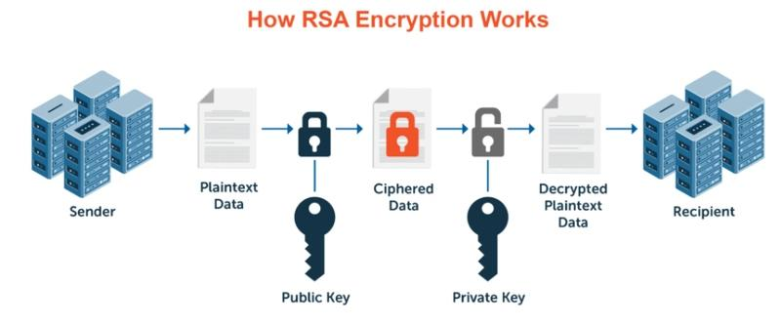
MODULE 3 — RSA-2048 KEY PROTECTION & MANAGEMENT
Purpose
RSA protects the AES encryption key and provides secure asymmetric key management.
Main Functions
RSA Key Pair Generation
Public Key Management
Private Key Protection
AES Key Encryption
AES Key Recovery
Process
GENERATE RSA KEY PAIR → RSA PUBLIC KEY + RSA PRIVATE KEY → GENERATE AES KEY → RSA PUBLIC KEY ENCRYPTS AES KEY → STORE ENCRYPTED AES KEY

Slide 8
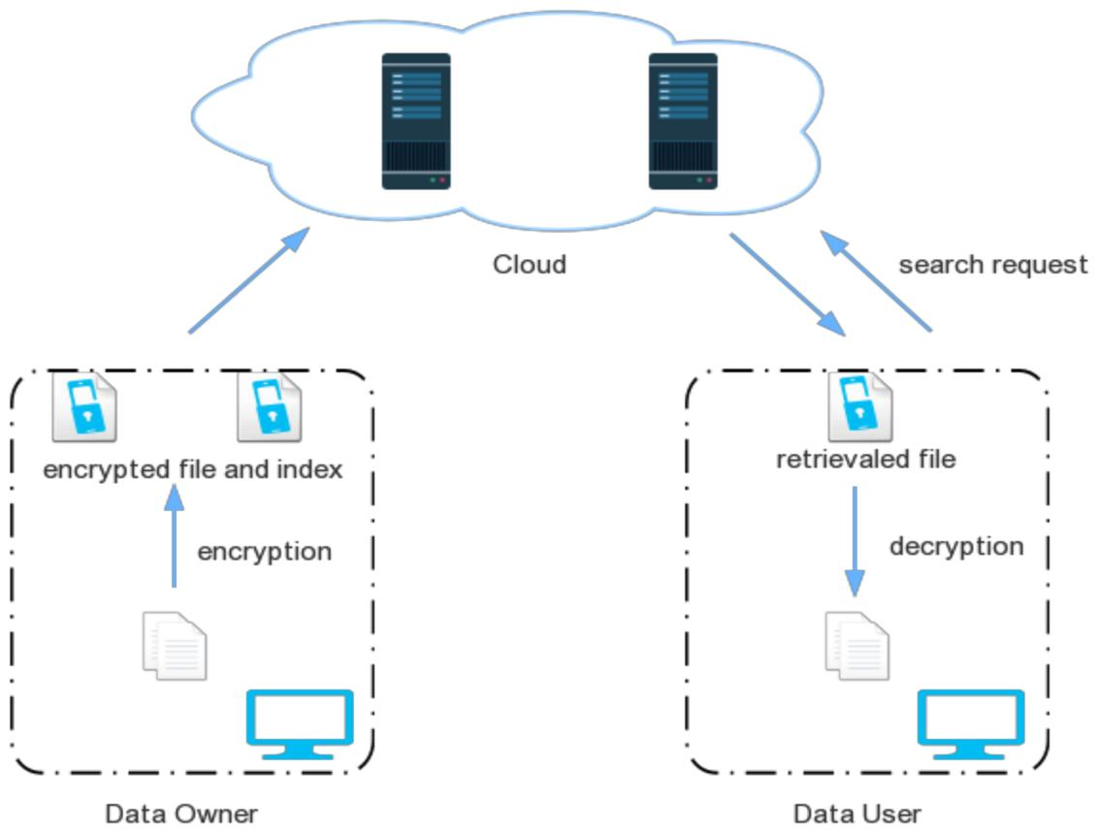
MODULE 4 — SECURE CLOUD UPLOAD, DOWNLOAD & DECRYPTION
Purpose
This module manages secure storage and retrieval of encrypted files from the cloud.
UPLOAD PROCESS
USER LOGIN → SELECT FILE → AES-256 ENCRYPTION → RSA PROTECT AES KEY → UPLOAD CIPHERTEXT → STORE ENCRYPTED AES KEY → CLOUD STORAGE
CLOUD STORAGE CONTAINS
ENCRYPTED FILE + RSA-PROTECTED AES KEY + FILE METADATA
DOWNLOAD PROCESS
USER LOGIN → AUTHENTICATION → REQUEST FILE → DOWNLOAD ENCRYPTED FILE → RETRIEVE RSA-PROTECTED AES KEY → RSA PRIVATE KEY → RECOVER AES KEY → AES DECRYPTION → ORIGINAL FILE

Slide 9
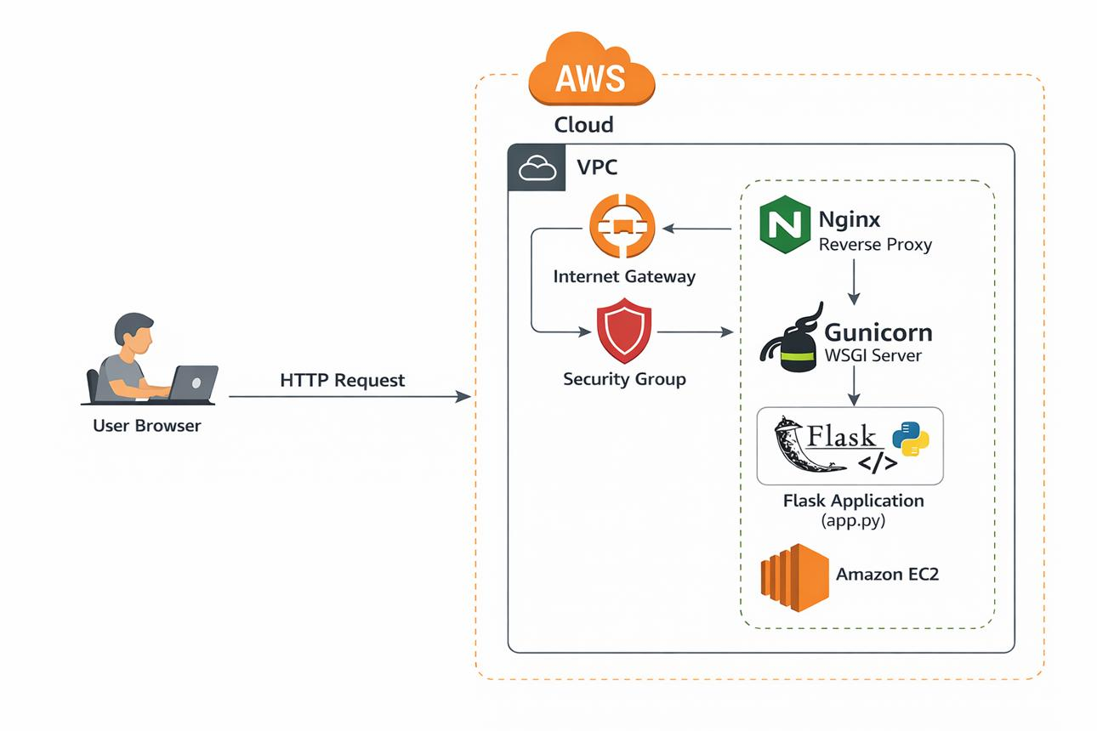
TOOLS & TECHNOLOGIES
Security Algorithms
AES-256 (File Encryption)
RSA-2048 (Key Encryption)
Software Tools
Python
Flask
HTML
CSS
Bootstrap
SQLite / MySQL
Visual Studio Code

Slide 10
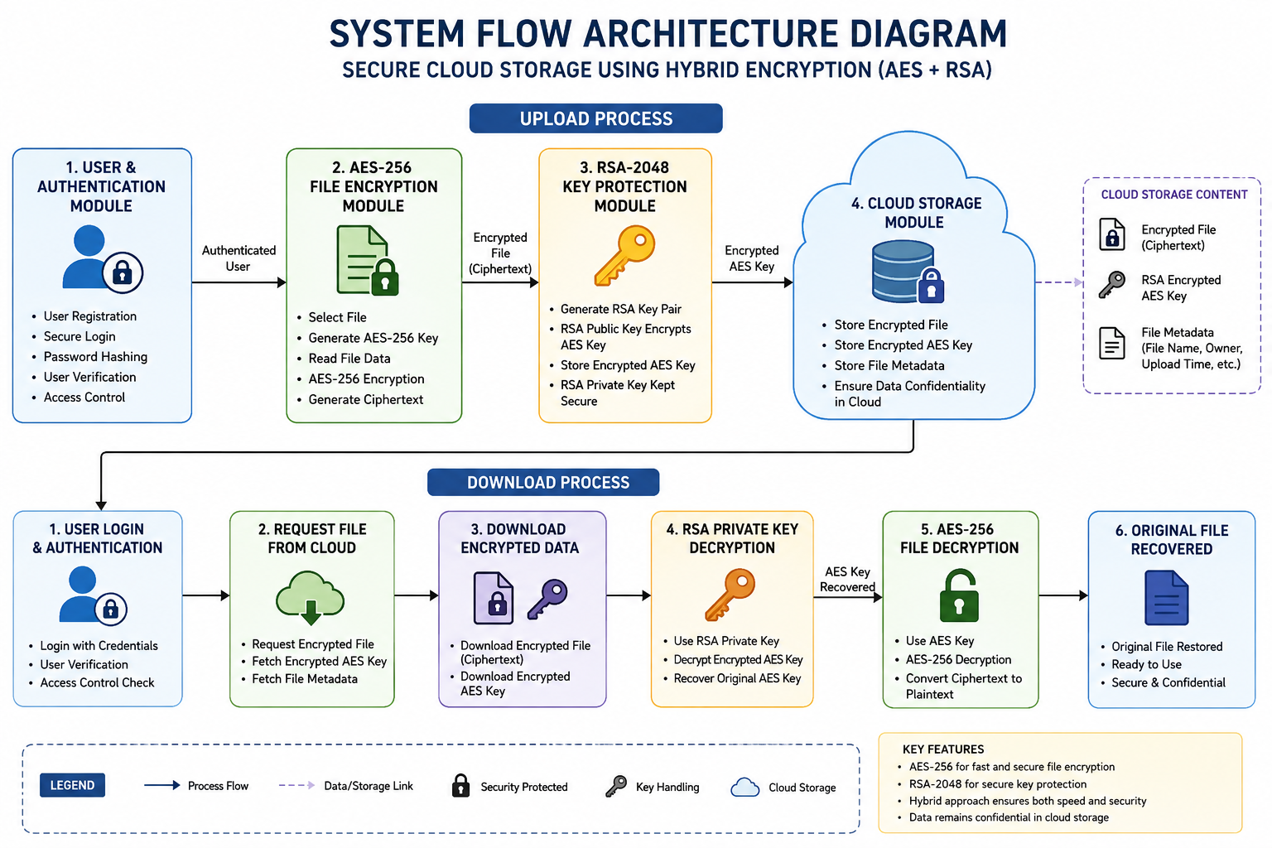

Slide 11
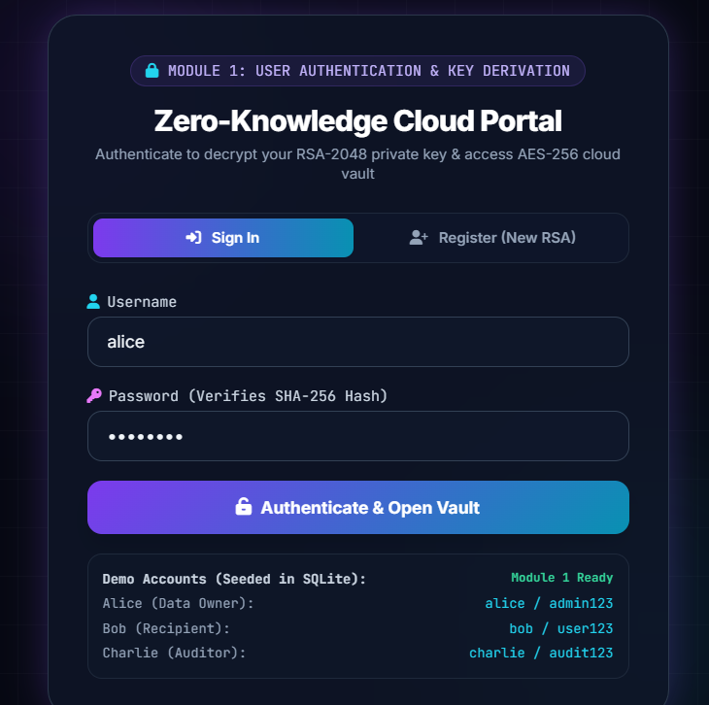
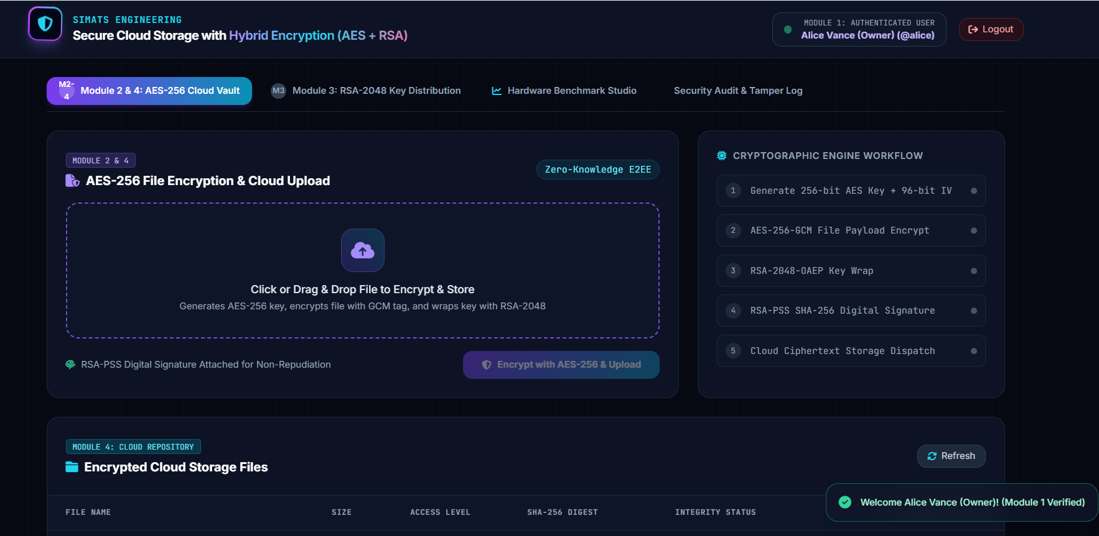
OUTPUT

Slide 12
CONCLUSION
The proposed Secure Cloud Storage with Hybrid Encryption Using AES and RSA provides a secure and efficient approach for protecting files stored in a cloud environment. The system combines AES for fast file encryption with RSA for secure AES key protection, thereby achieving both high performance and strong security. User authentication ensures that only registered and authorized users can access the system, while encrypted file storage protects sensitive data from unauthorized access.
Key Conclusion Points
User Authentication ensures that only authorized users can access the cloud storage system.
AES encryption provides fast and efficient protection for files, making it suitable for large data.
RSA encryption securely protects and distributes the AES session/encryption keys.
The hybrid encryption approach combines the speed of symmetric encryption with the secure key management of asymmetric encryption.

Slide 13
FUTURE ENHANCEMENTS
🔐 Multi-Factor Authentication
Add OTP or authenticator-based verification.
🔄 Automatic Key Rotation
Periodically replace encryption keys.
🛡️ AES-GCM
Provide both confidentiality and authenticated integrity.
👥 Role-Based Access Control
Allow different permissions for different users.
📤 Secure File Sharing
Enable controlled sharing of encrypted files.
📊 Audit Logging
Record file access and security-related events.
☁️ Multi-Cloud Support
Store encrypted data across multiple cloud platforms.
🔑 Hardware Security Modules
Provide stronger protection for sensitive private keys.

Slide 14


